Slide 1
Visualizing complexity

Slide 2


Slide 3
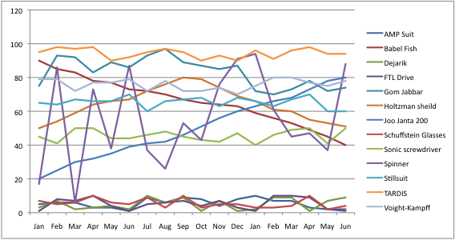
Multivariate

Slide 4
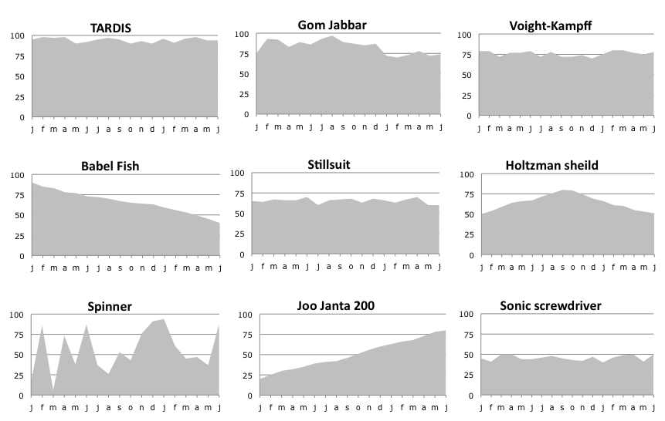

Slide 5
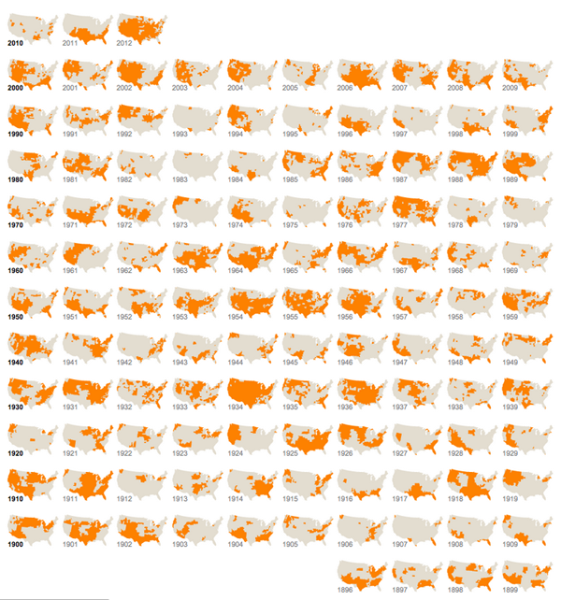
Drought footprint
http://www.nytimes.com/interactive/2012/07/20/us/drought-footprint.html?_r=0

Slide 6
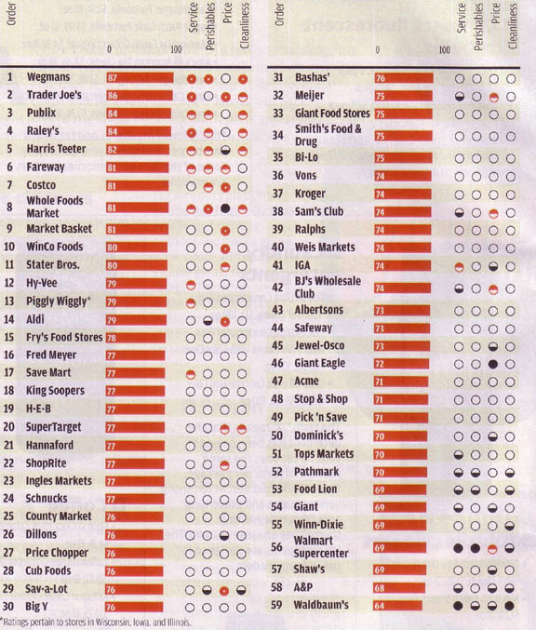

Slide 7
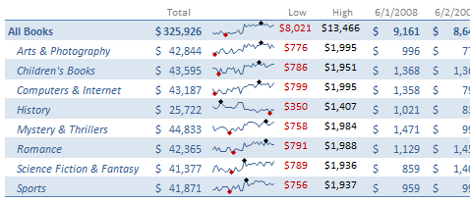

Slide 8
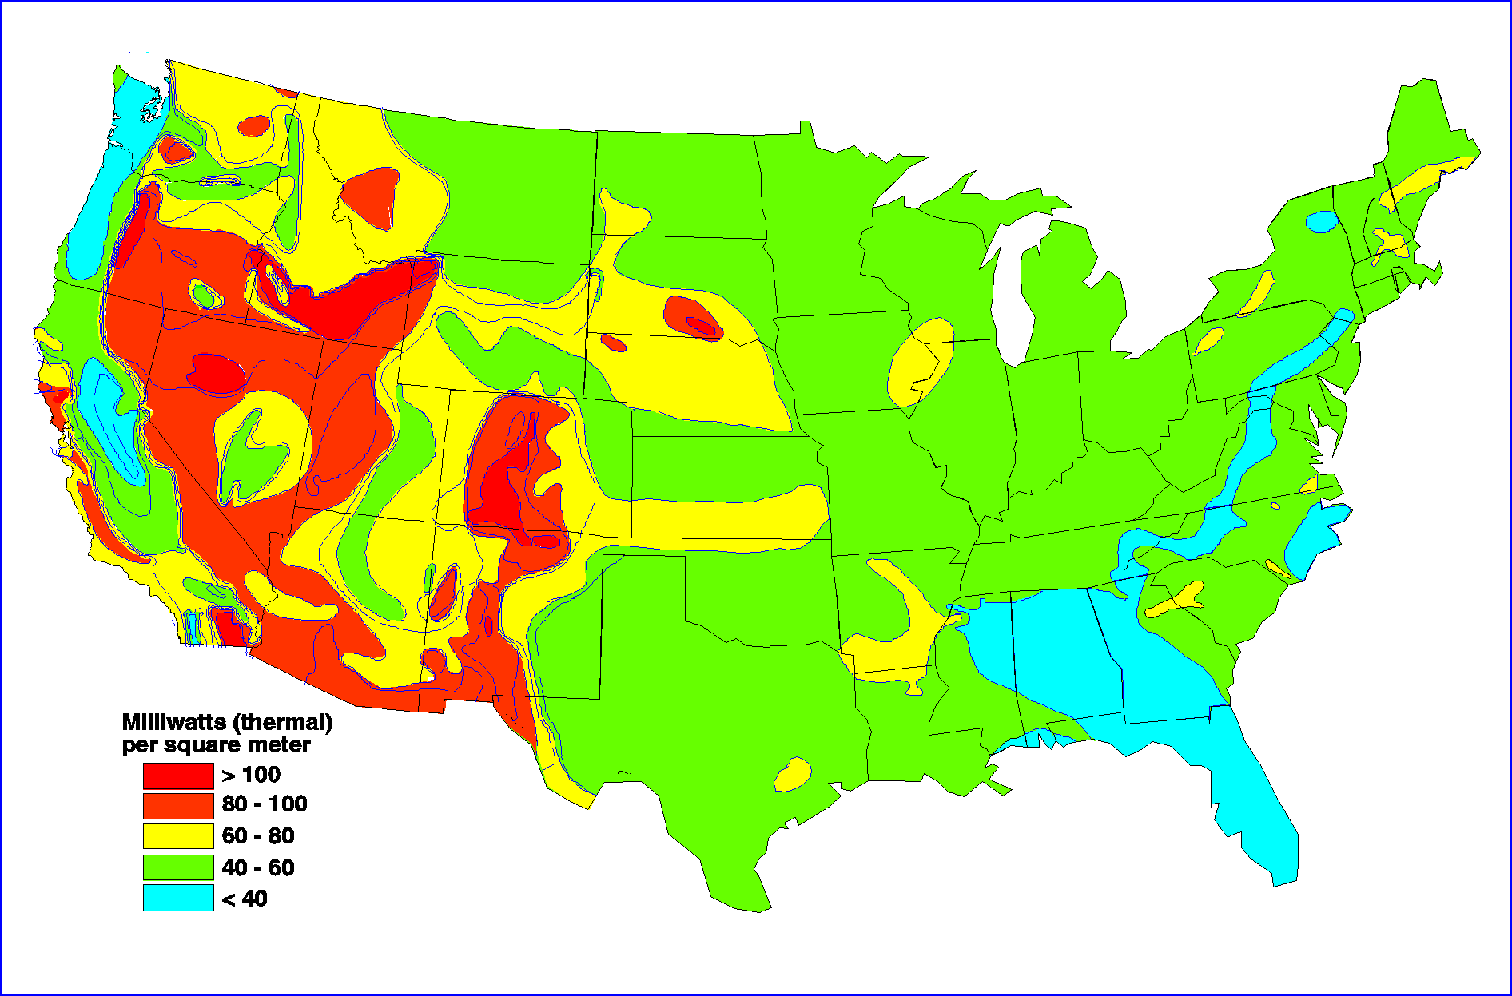

Slide 9
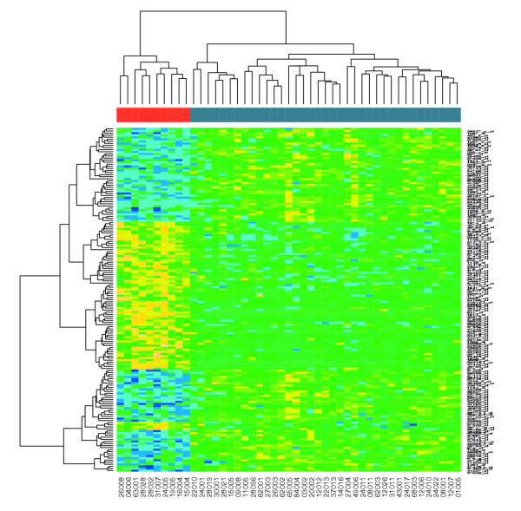

Slide 10
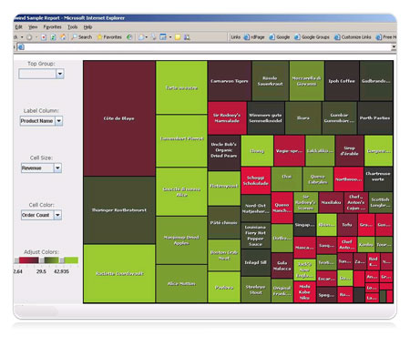

Slide 11
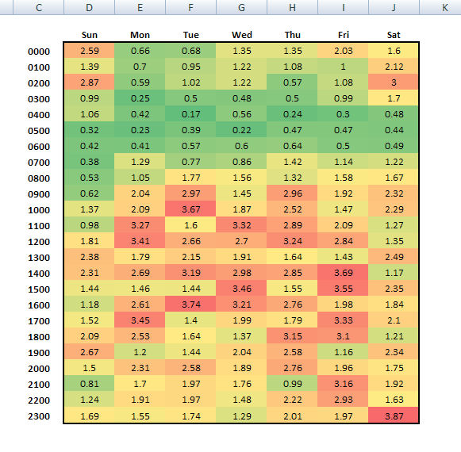

Slide 12
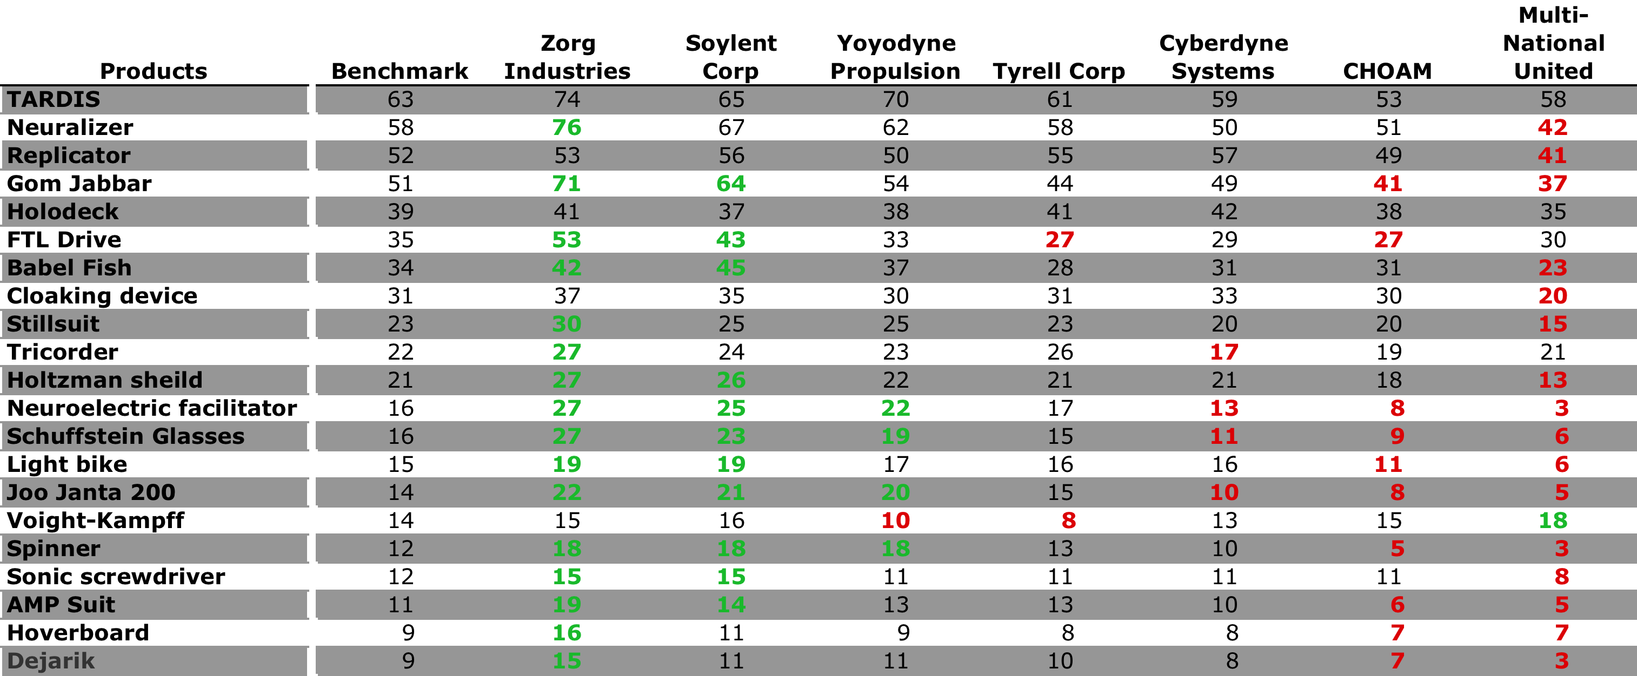

Slide 13
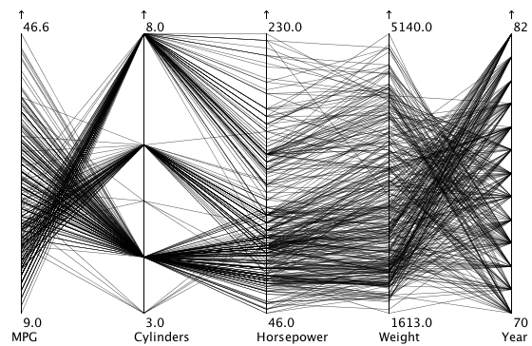
Notes:
Since the variables along the x axis are not comparable on the same chart, the length and angle of lines are misleading

Slide 14
Chevy
Nova

Slide 15
Suzuki
Alto

Slide 16
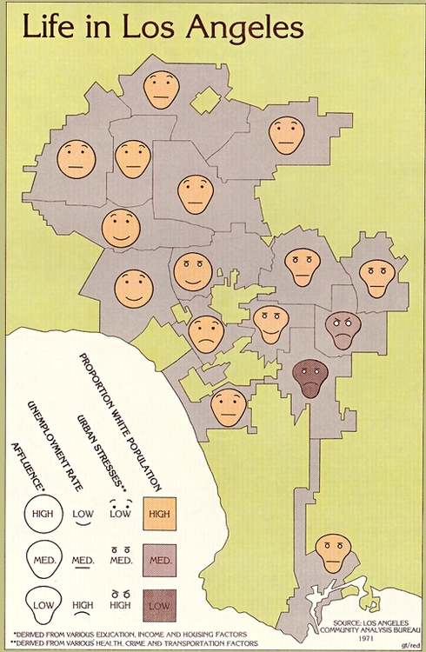

Slide 17
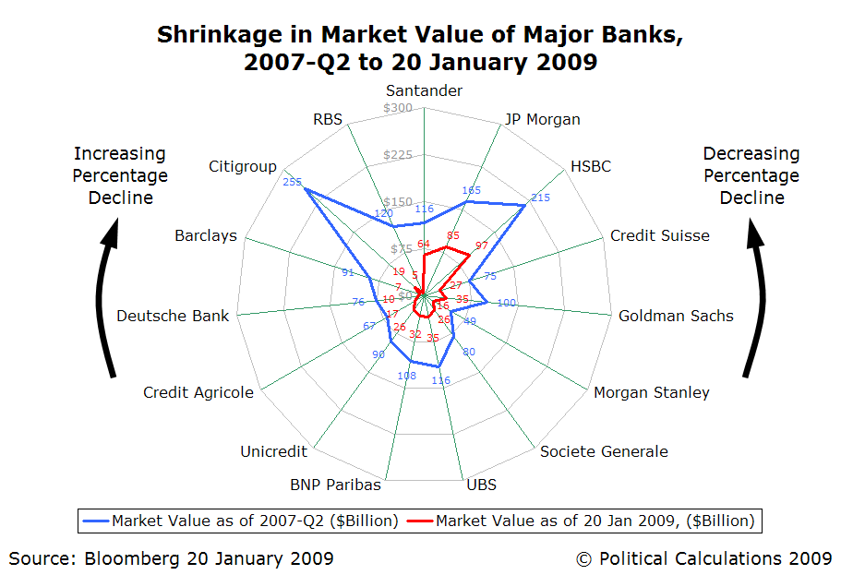
http://www.ritholtz.com/blog/wp-content/uploads/2009/02/radar-chart-shrinkage-in-market-value-of-major-banks-2007q2-to-20-jan-2009.png
Notes:
Star charts are radar charts without the lines
Spider charts are radar charts without the area

Slide 19
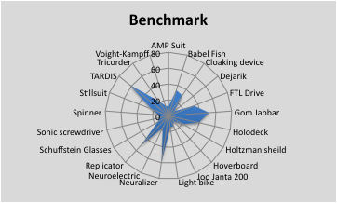
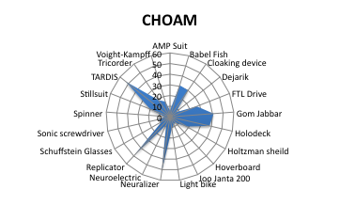
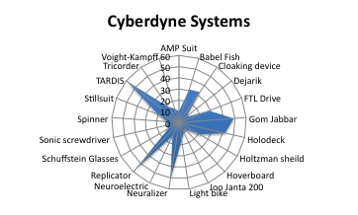
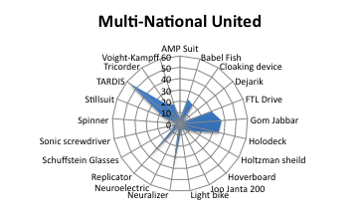
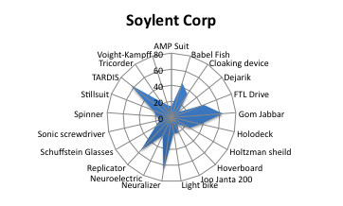
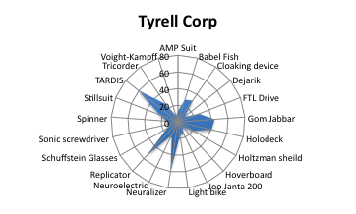
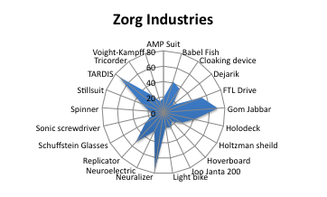
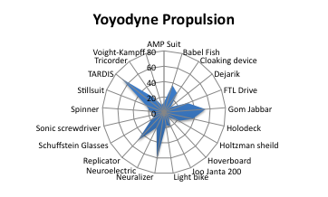

Slide 20
Notes:
Here is the same data, represented in a table.

Slide 21
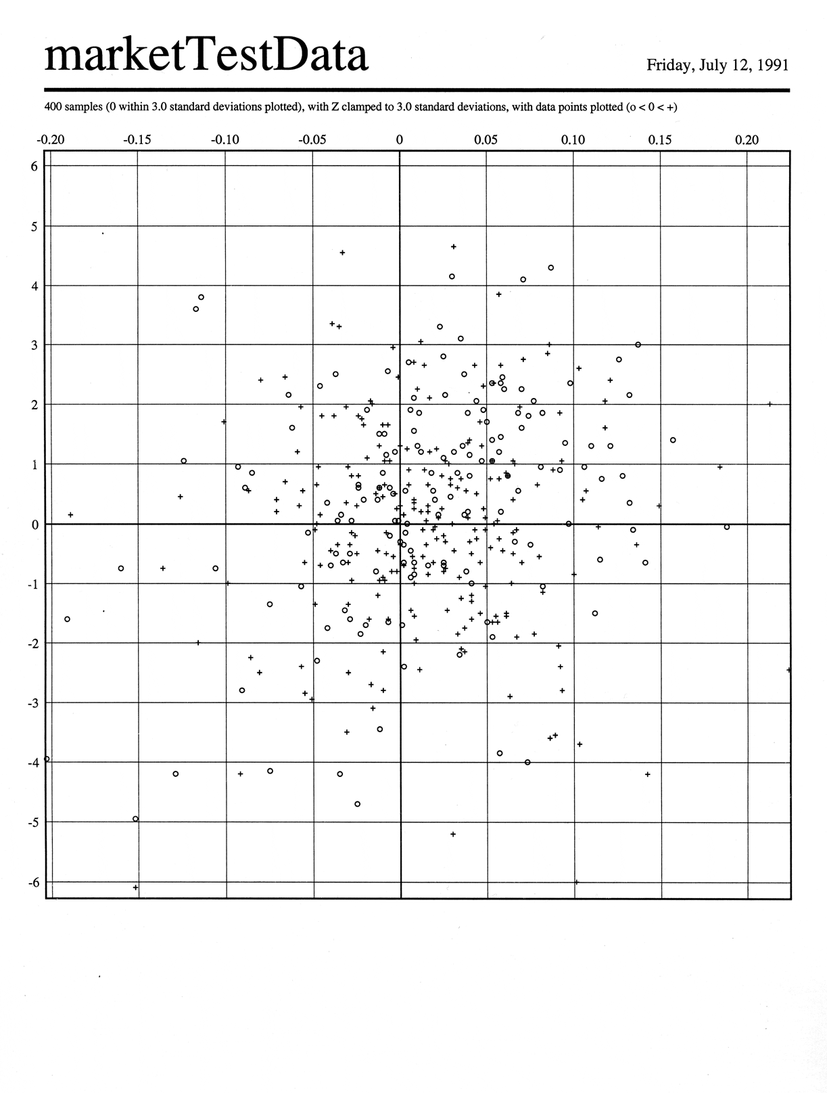
http://wbpaley.com/brad/images/graphics/gaussian2.gif

Slide 22
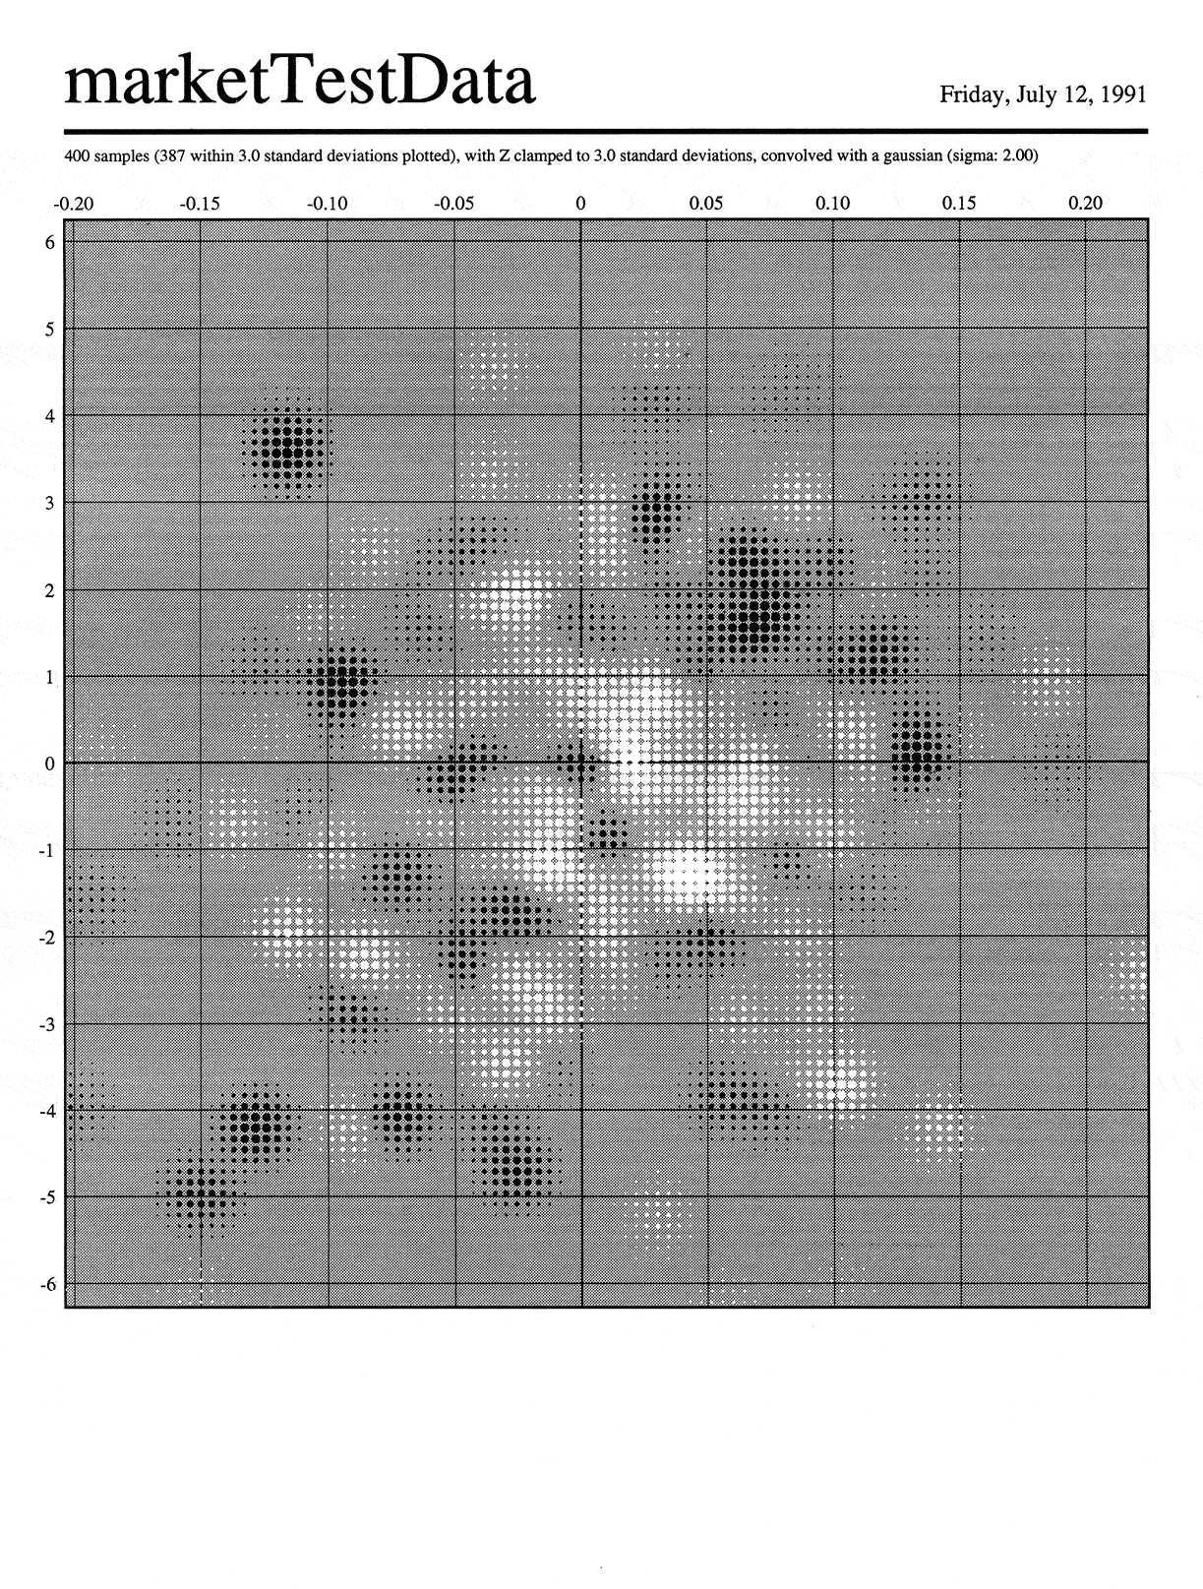
http://wbpaley.com/brad/images/graphics/gaussian2.gif

Slide 23
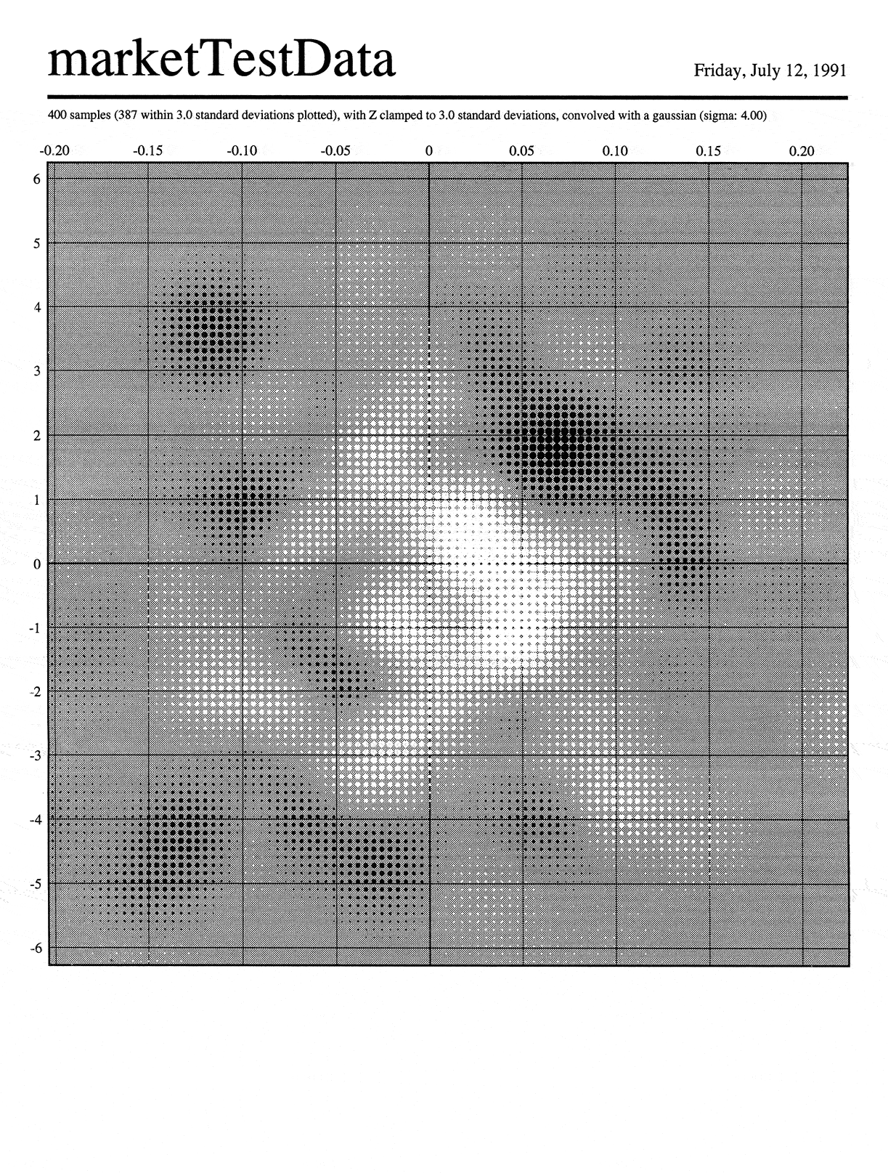
http://wbpaley.com/brad/images/graphics/gaussian2.gif

Slide 24
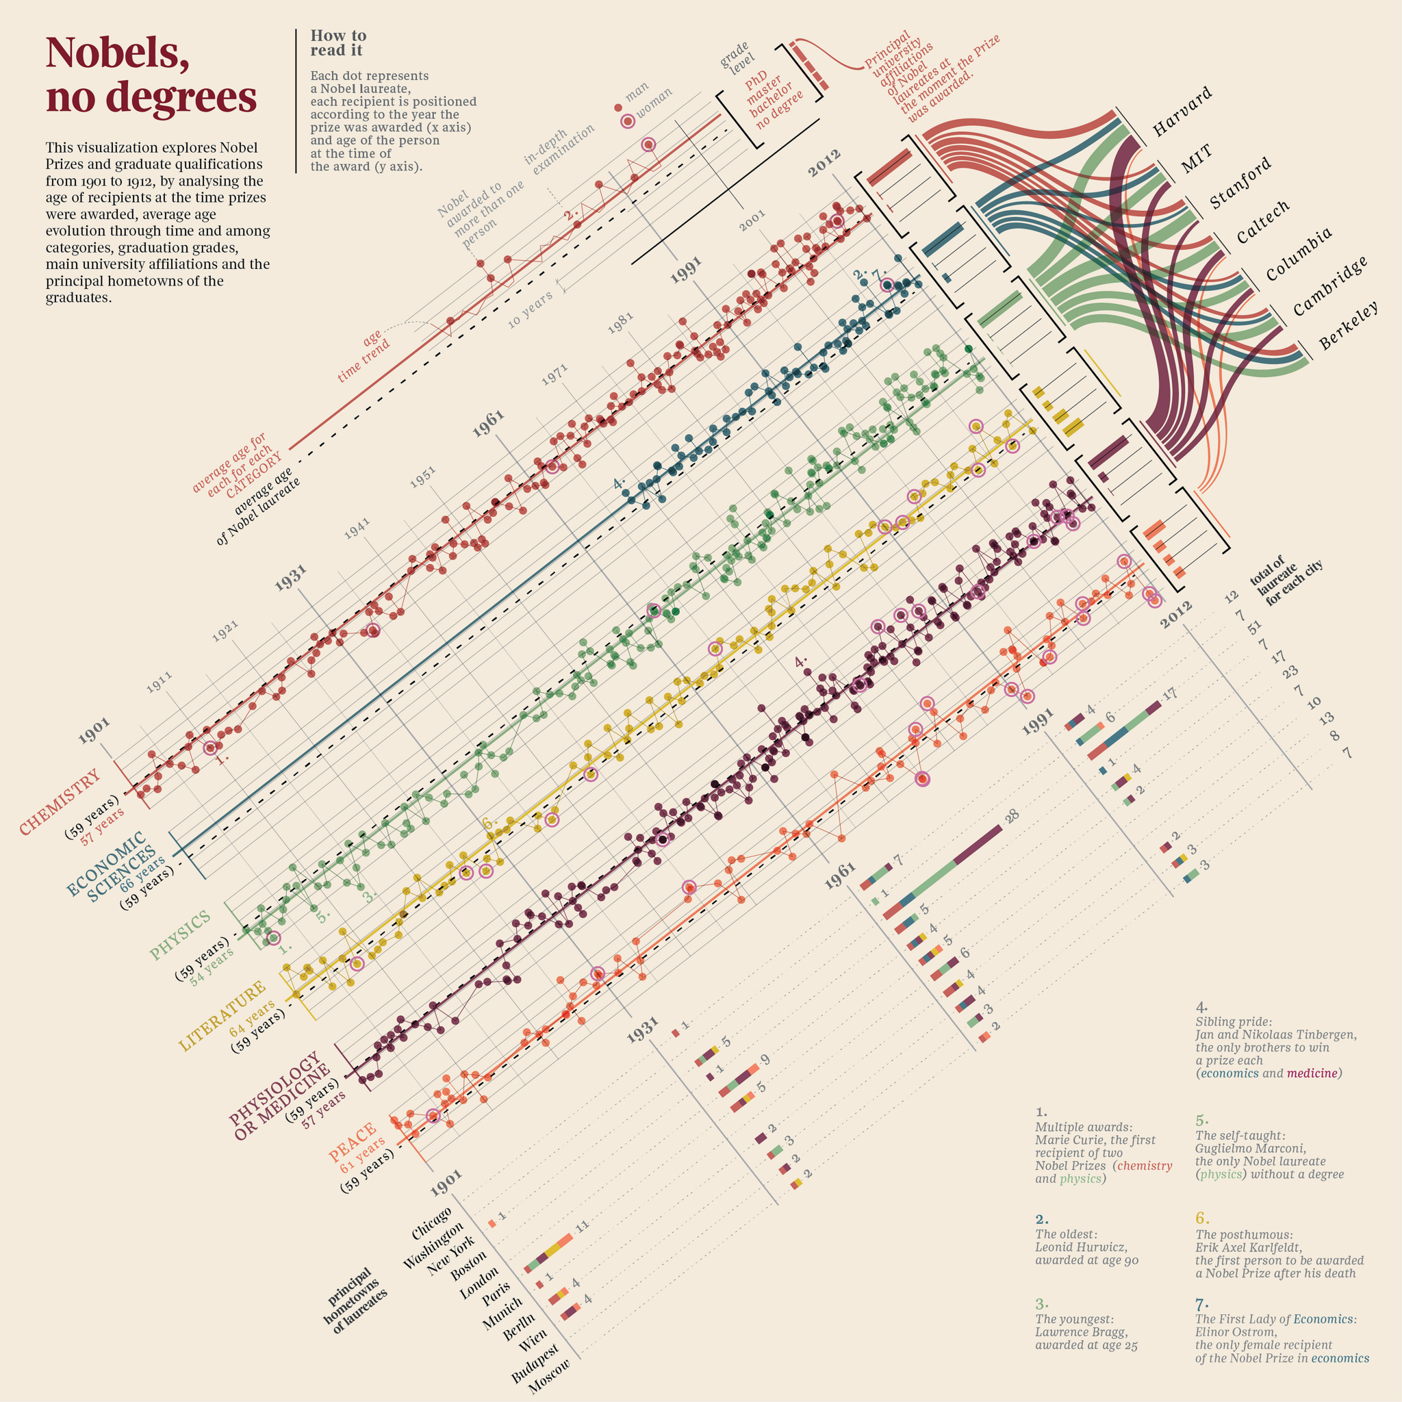
Creators: accurat.it
Notes:
2013 winner of Information is Beautiful contest

Slide 25
Nobel
No degrees
Notes:
After turning it right side up and blowing it up a bit you can see the authors looked at age, gender, type of degree, type of peace prize. Spark lines, bar charts, scatter plot, and pivot graph. The conclusion is that for the most part, few Nobels are awarded without degrees, hence the title “Nobels, no degrees.”
I have conducted some significant research of my own and come up with three alternative titles.

Slide 26
Nobel
n00bs
Notes:
Nobel n00bs, referring to the relatively late arrival of economic “sciences” to the nobel scene.

Slide 27
New York
New York
Notes:
New York, New York referring to the clear bias towards a new york residence for Nobel winners.

Slide 28
No Bears
No Peace
Notes:
And probably most significant, given this course’s affiliation with UC Berkely and the fact that no Cal grad has ever one a Nobel Prize for Peace, No Bears, no peace.

Slide 29
networks

Slide 30
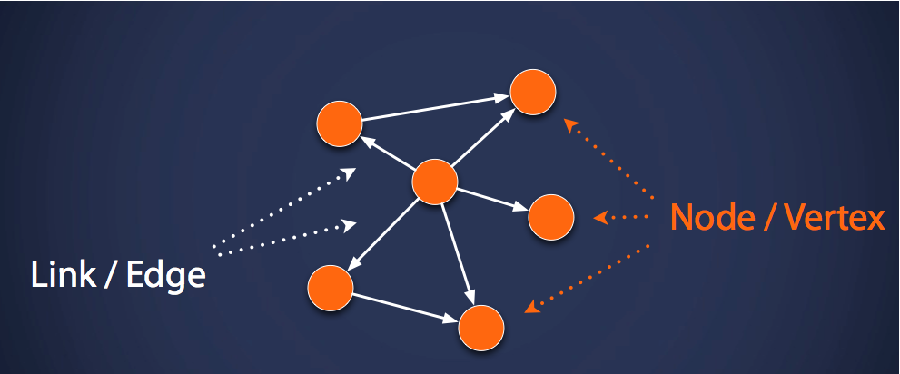
Terminology
Arc/

Slide 31
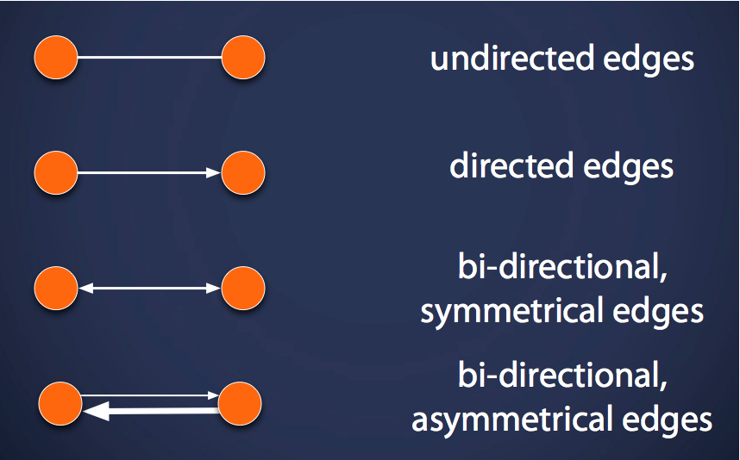
arcs
arcs
arcs
arcs

Slide 32
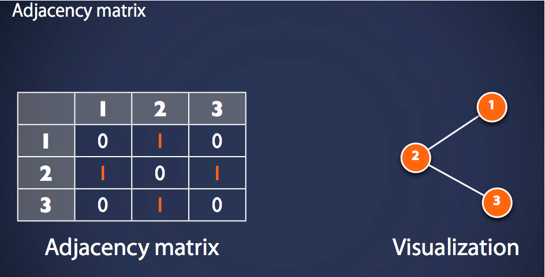

Slide 33
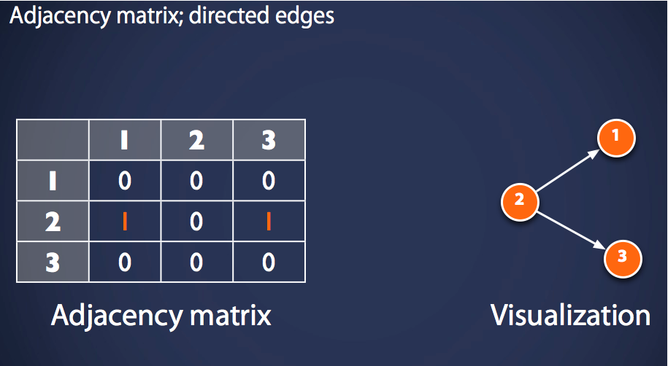
arcs

Slide 34
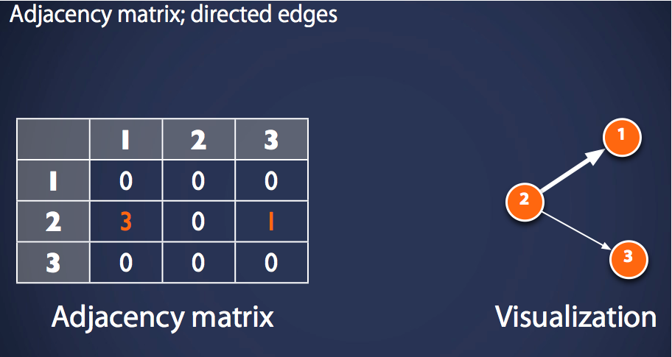
arcs

Slide 35
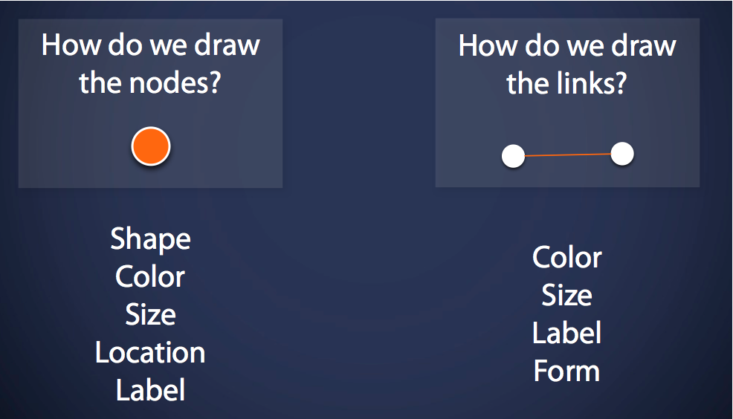

Slide 36
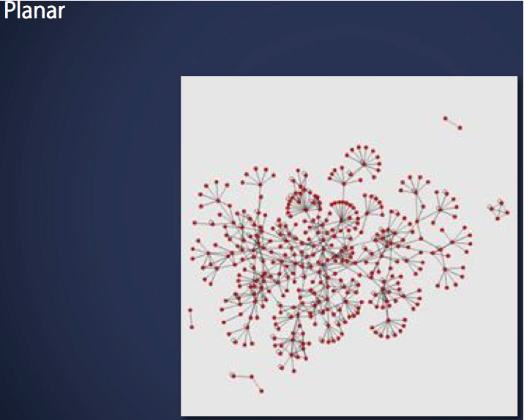

Slide 37
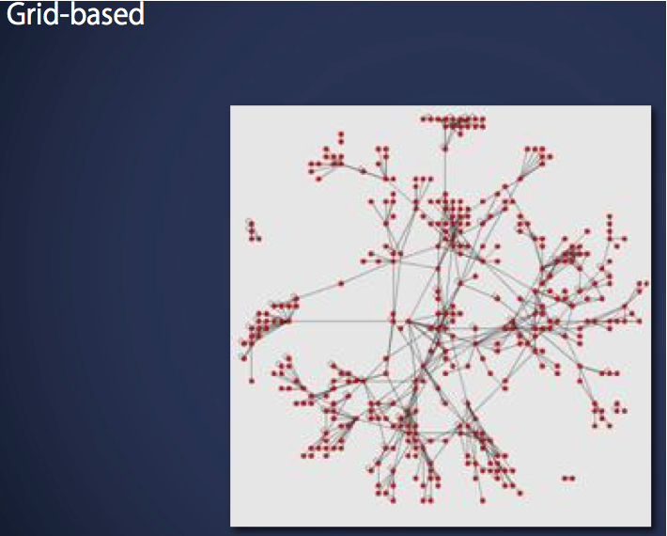

Slide 38
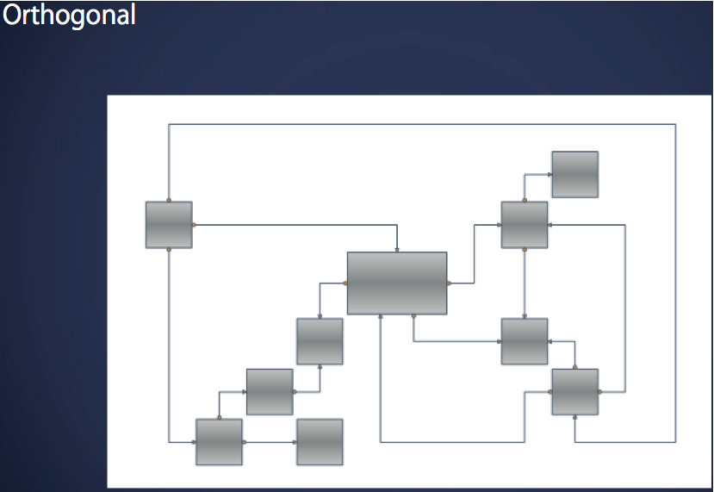

Slide 39
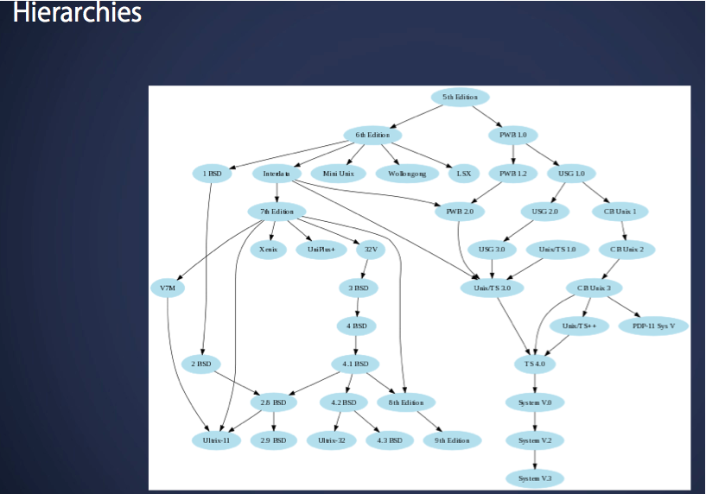

Slide 40
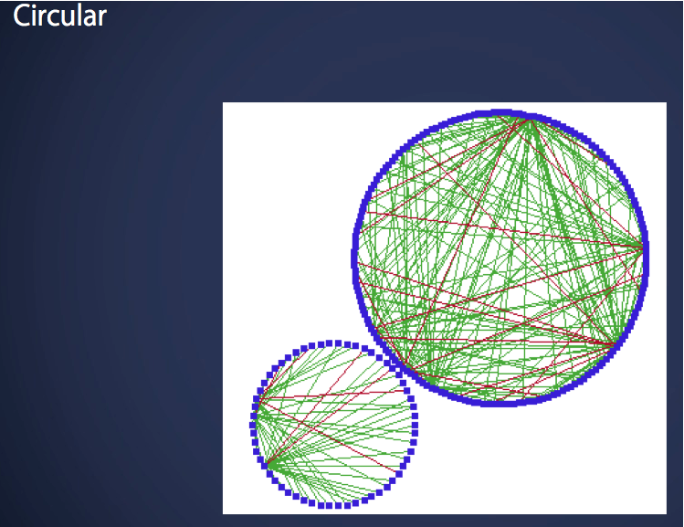

Slide 41
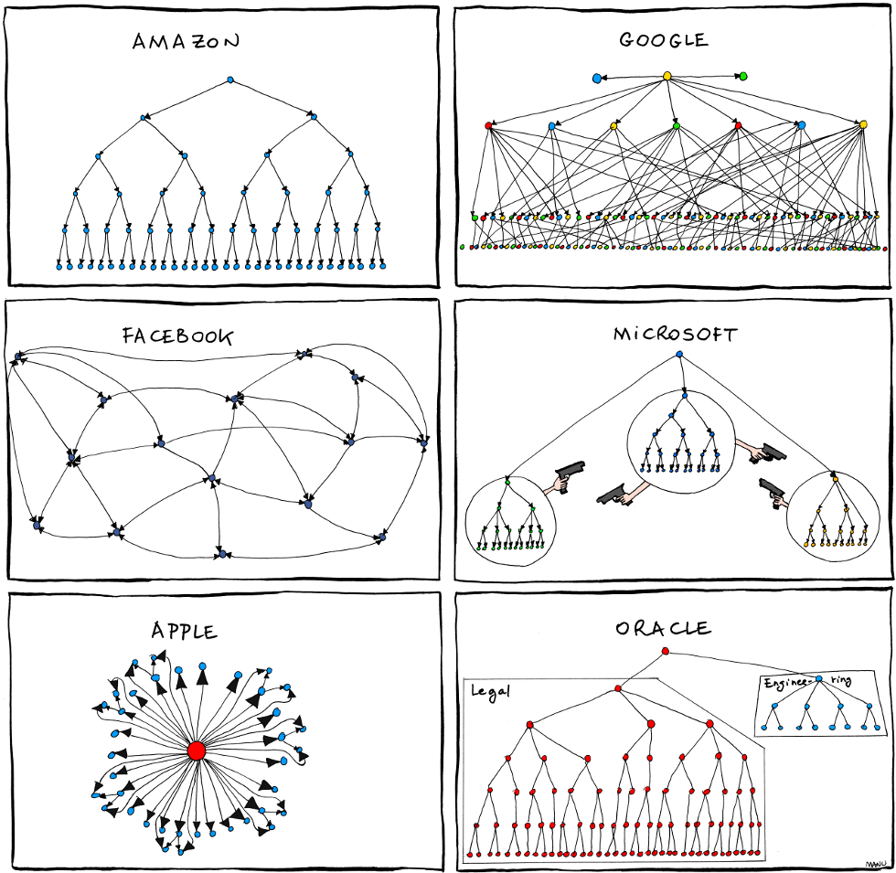
http://www.ritholtz.com/blog/wp-content/uploads/2013/07/2011.06.27_organizational_charts.png

Slide 42
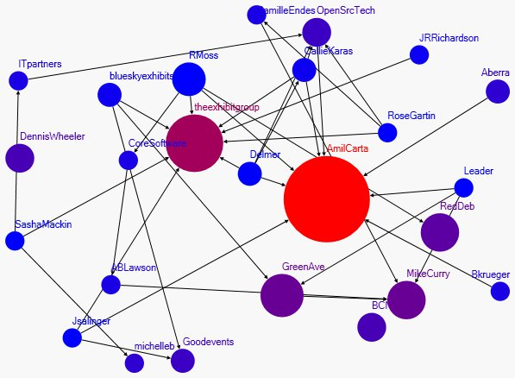
http://predictive-marketing.com/wp-content/uploads/2010/06/Conference-Network-Graph1.jpg
Notes:
Very simple

Slide 43
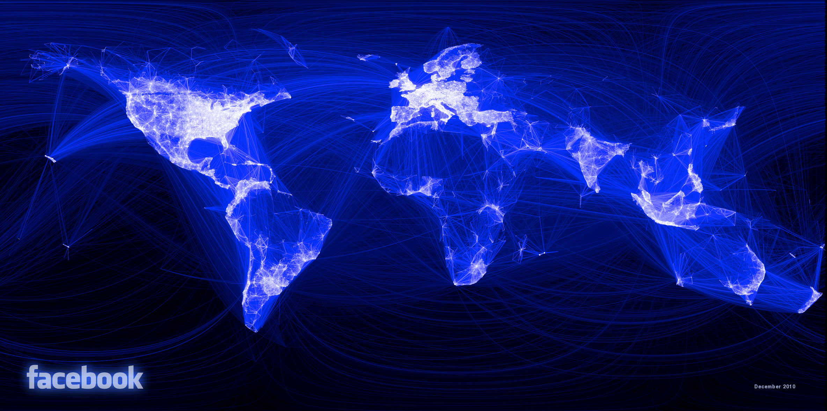
http://gigaom2.files.wordpress.com/2010/12/163413_479288597199_9445547199_5658562_14158417_n.png
Notes:
To the complex

Slide 44
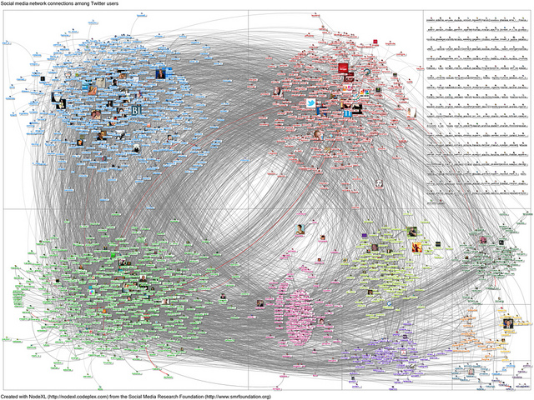
http://www.peterpappas.com/images/2012/03/NodeXL-Twitter-User-jowyang-network-graph.jpg
Notes:
Learning: from Face-to-Face to Networked Individualism » NodeXL-Twitter-User jowyang network graph
This is an example of twitter user jowyang’s network where we begin to see the network as art

Slide 45
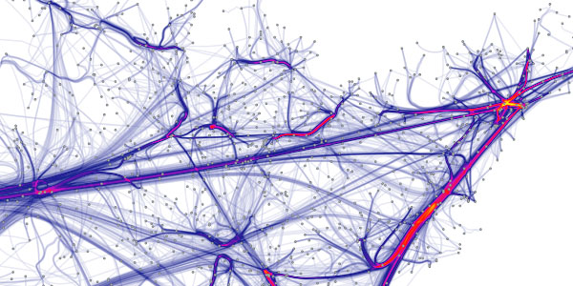
http://static.vizworld.com/wp-content/uploads/2009/06/force_bundles.jpg

Slide 46
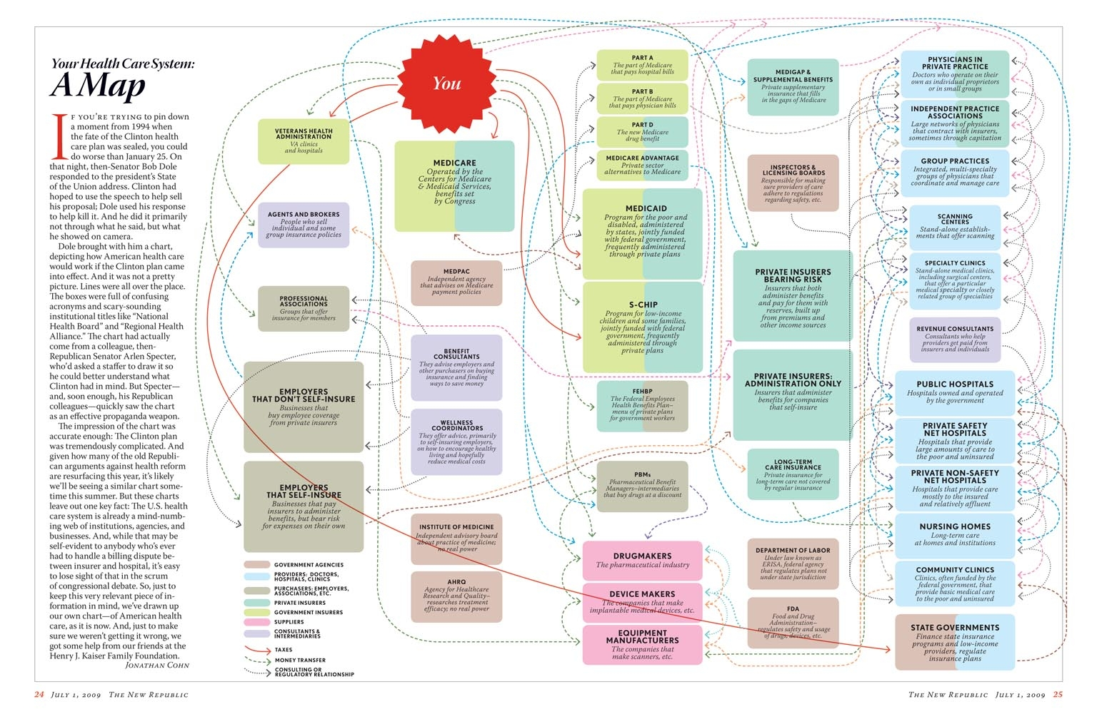
http://voices.washingtonpost.com/ezra-klein/assets_c/2009/07/HealthCareMap.html

Slide 47
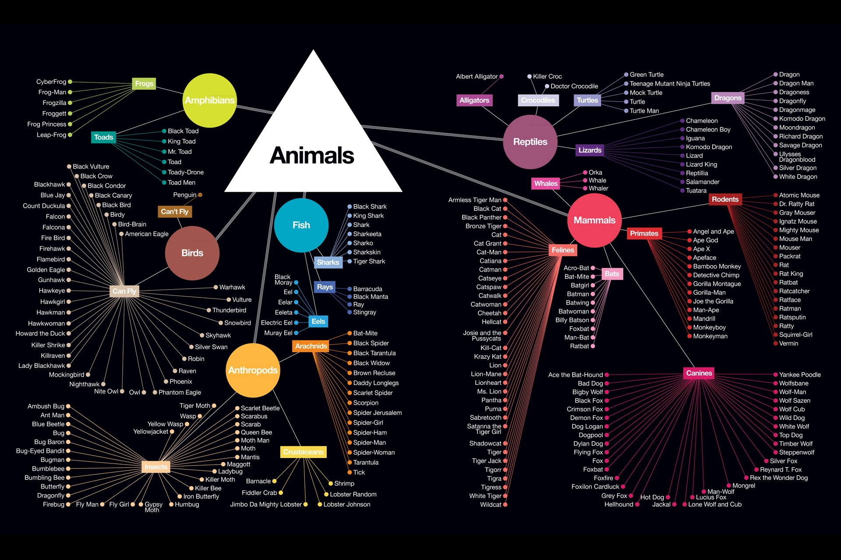
http://timleong.com/Animal-Taxonomy-of-Comic-Book-Characters

Slide 48
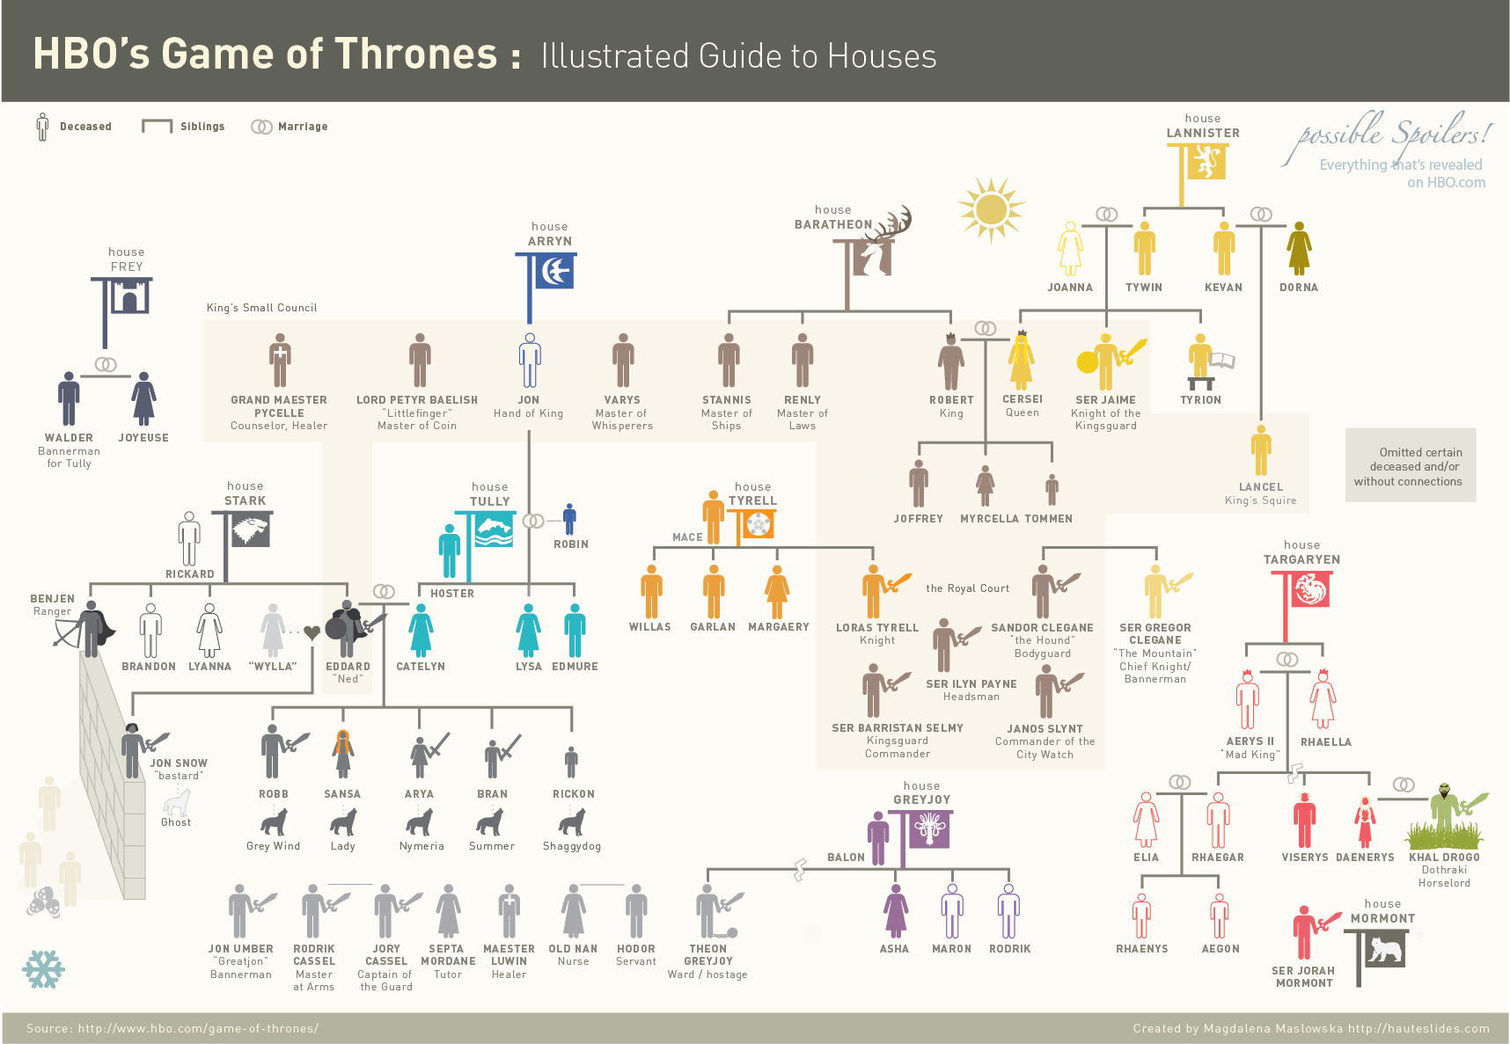
http://gamesofthrones.com/wp-content/uploads/2011/05/Game-of-Thrones-Infographic-Houses-Only.png
Notes:
This example is from the game of thrones, published on the HBO website. That provides continuous connection to their viewers during the off season. Of particular interest here is the intuitive use of glyphs to add helpful information along the way. Entwined rings to represent marriages. A break line to show that Theon GreyJoy was cut-off from the family

Slide 49
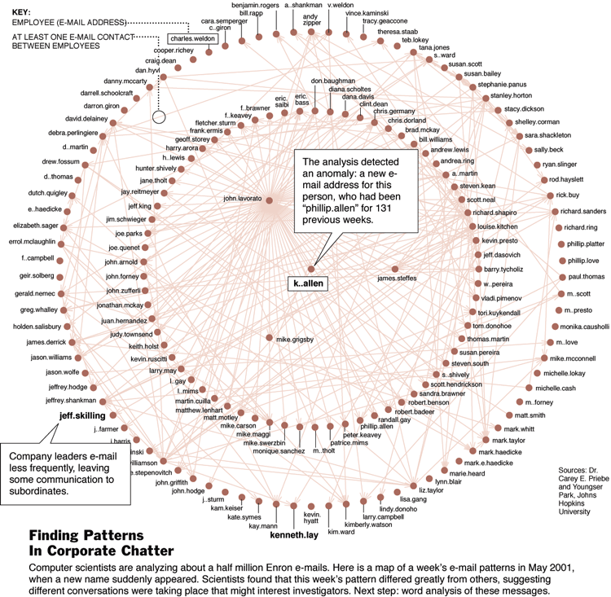

Slide 50
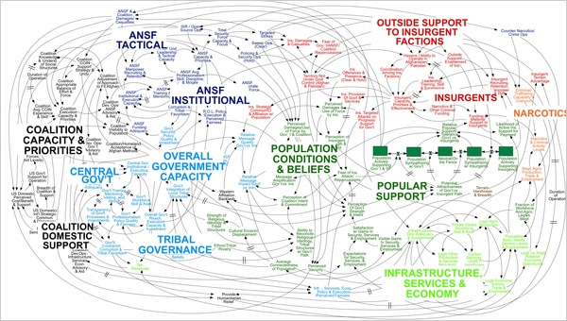

Slide 51
Reducing the complexity of network graphs
Notes:
When I was in graduate school the struggle was to get enough ‘real estate’ as in wall space to plot all of our points. Now the biggest struggle is how to reduce the complexity so that the reader can see the forest and the trees.

Slide 52
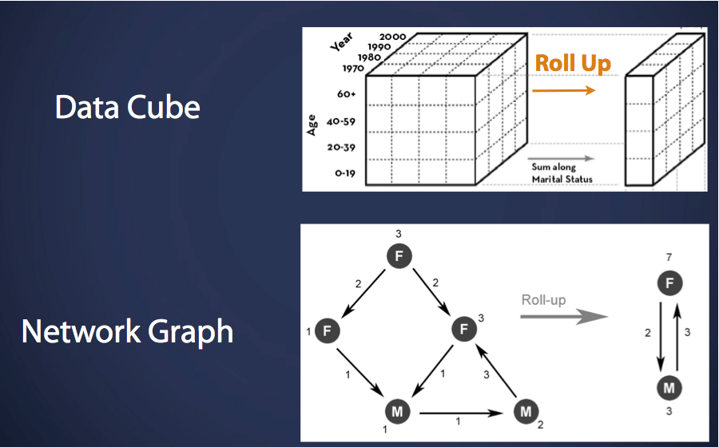

Slide 53
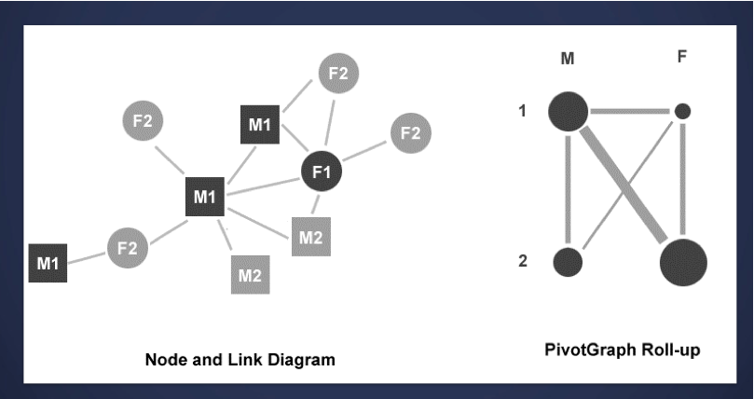

Slide 54
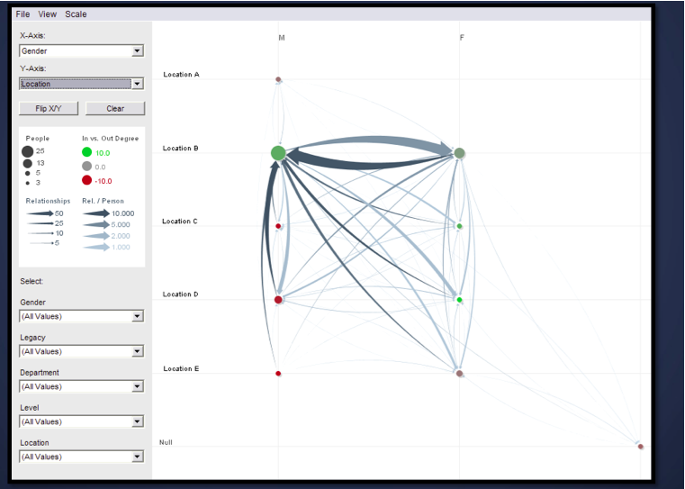
Notes:
Here is an example of what the end result looks like, where the godian knot of fine lines is replaced by thicker lines representing their aggregation.

Slide 55
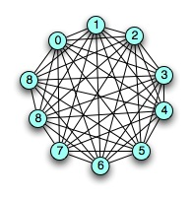



http://scientopia.org/blogs/goodmath/2007/07/03/edge-coloring-and-graph-turning/
Notes:
Another approach that can be done mathmatically or manually is demonstrated by this series.

